Slide 1

Portfolio Review
Qualified All Equity Model
MAY 2026

Slide 2




Your Presenters Today
Paolo LaPietra, CFP®
Ed Wilhelm
Casey Bird
Director of Portfolio Strategy
Senior Portfolio Trader
Senior Portfolio Trader

Slide 3
Agenda
01 Holdings & Allocation
02 Performance Overview
03 The AI Trade November Rebalance
04 The AI Trade Second Leg
05 Summary

Slide 4
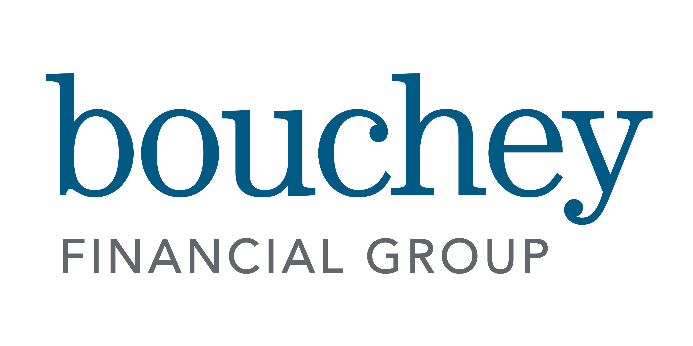
Equity Holdings
Current positions and how the sleeve is constructed
POSITIONS
HOW IT'S BUILT
VOO
Vanguard Large Cap
12
POSITIONS
QQQM
Invesco QQQM
A focused sleeve spanning broad market exposure, dividend and quality factors, and targeted thematic positions.
SCHD
Schwab Dividend
DUHP
DFA High Profitability
DGRW
WisdomTree Quality Dividend
5
NEW POSITIONS
AAPL
Apple
SMH, NLR, and HODL added in November; DRAM and MSFT added in April. NLR fully exited at the April trade.
AMZN
Amazon
SMH
VanEck Semiconductor
DRAM
Roundhill Memory
2
AI REBALANCES
VO
Vanguard Mid-Cap
A November repositioning into AI infrastructure and an April rotation into memory and large-cap software.
MSFT
Microsoft
HODL
VanEck Bitcoin
Bouchey Financial Group | For Discussion Purposes Only | May 2026

Slide 5
Allocation Profile
Style and sector exposure across the equity sleeve
STYLE BOX
SECTORS
VALUE
BLEND
GROWTH
Technology
48.3%
LARGE
23.2%
36.0%
24.1%
Consumer Cyclical
12.0%
Communication Services
8.6%
Healthcare
7.0%
MID
5.0%
7.1%
3.8%
Consumer Defensive
6.0%
Industrials
5.9%
Financial Services
5.6%
SMALL
0.4%
0.3%
0.0%
Energy
3.3%
Utilities
1.4%
Basic Materials
1.2%
Real Estate
0.7%
As of May 7, 2026. Look-through exposure for the equity sleeve.
Bouchey Financial Group | For Discussion Purposes Only | May 2026

Slide 6
Performance Overview
BFG Equity Sleeve vs. S&P 500
YEAR TO DATE
1 YEAR
SINCE NOV 21, 2025
+14.2%
+32.6%
+18.3%
SPY: +7.8% | +6.4%
SPY: +27.2% | +5.4%
SPY: +12.8% | +5.5%
PERFORMANCE COMPARISON
Bouchey Financial Group | For Discussion Purposes Only | May 2026

Slide 7
Position Performance
All Equity sleeve, returns through May 11, 2026
Symbol | Name | YTD Return (or since added) | vs. SPY
SMH | VanEck Semiconductor | +52.3% | +44.5%
DRAM * | Roundhill Memory * | +44.5% | +38.9%
SCHD | Schwab Dividend | +16.3% | +8.5%
AMZN | Amazon | +14.7% | +6.9%
QQQM | Invesco QQQM | +14.2% | +6.4%
AAPL | Apple | +8.4% | +0.6%
VOO | Vanguard Large Cap | +7.8% | 0.0%
MSFT * | Microsoft * | +4.1% | -1.5%
DGRW | WisdomTree Quality Dividend | +6.3% | -1.5%
VO | Vanguard Mid-Cap | +6.2% | -1.6%
DUHP | DFA High Profitability | +4.4% | -3.4%
HODL | VanEck Bitcoin | -8.2% | -16%
* Position added April 14, 2026. DRAM & MSFT Returns shown since acquisition rather than year-to-date. "vs. SPY" column compares each position to SPY over the same period.
Bouchey Financial Group | For Discussion Purposes Only | May 2026
Notes:
NUMBERS ARE AUDTIED AND GOOD

Slide 8
The AI Trade
November 2025 Rotation
Notes:
Thanks Paolo -
I’m going to be covering the first part of our AI trade, specifically our tactical rotation back in November 2025

Slide 9
The AI Trade
November 21, 2025
REDUCED EXPOSURE
INCREASED EXPOSURE
Symbol | Name | Action | Since
SCHD | Schwab Dividend | Trim 4% weight | +16.4%
AAPL | Apple | Trim 1% weight | +16.0%
XLV | Health Care SPDR | Trim 4% weight | -6.11%
Symbol | Name | Action | Since
SMH | VanEck Semiconductor | Add 3% weight | +66.3%
NLR | Uranium & Nuclear | Add 3% weight | +19.5%
HODL | VanEck Bitcoin | Add 3% weight | -4.4%
THE RESULT
+20.6%
Net Trade Performance
The November trade shifted weight from defensive and dividend exposures into thematic positions in semiconductors, nuclear energy, and digital assets. The semiconductor and nuclear adds have driven the bulk of relative performance; the bitcoin allocation lagged early but has rallied 10% over the past month.
Bouchey Financial Group | For Discussion Purposes Only | May 2026
Notes:
November gave us the first real shake in the AI trade. The S&P 500 pulled back about 5% into mid November, and the selling was concentrated in the names that had led all year.
Nvidia, Oracle, Microsoft all under pressure. The narrative was that AI capital spending had gotten circular and the whole buildout was at risk.
We saw it differently. We view the AI story as a structural shift, not a trade, and the market was offering it at a discount. So -- on the 21st of November we trimmed some defensive and dividend exposure within our model and added weight where the selloff was deepest - semiconductors through SMH and nuclear power through NLR.
We also wanted to take advantage of the volatility in crypto so we included an allocation to bitcoin via HODL.
Six months later, SMH is up over 65% and we clipped NLR at a 20% profit.

Slide 10
SMH · VanEck Semiconductor ETF
Added November 21, 2025
PRICE PERFORMANCE · INDEXED FROM ACQUISITION
RETURN SINCE ACQUISITION
+66.3%
vs. SPY +12.8% over the same period
Concentrated exposure to the top names in the chip supply chain
Foundation of our AI exposure
Beneficiary of the $725 billion being spent by other large cap tech companies
Bouchey Financial Group | For Discussion Purposes Only | May 2026
Notes:
Lets talk about SMH
As the foundation of our AI exposure, SMH has done exactly what we asked it to. Up 66% since we added it in November, while the broader market has returned about 13% over the same stretch.
Semiconductor chips sit underneath everything else in the AI stack. The models, the applications, the cloud platforms, all of it runs on chips. So - when companies like Microsoft, Meta, and Google commit another $725 billion to AI infrastructure, those dollars flow straight to the companies inside this ETF.
And the earnings have followed. Global chip sales were up nearly 80% year over year in March, and the industry is on pace to cross $1 trillion in revenue this year.
The names in here are putting up real numbers & continue to justify their valuations.

Slide 11
NLR · VanEck Uranium & Nuclear ETF
Bought November 21, 2025 · Sold April 14, 2026
PRICE PERFORMANCE · INDEXED FROM ACQUISITION
Return from Buy to Sell
+19.5%
Broad exposure to uranium miners and nuclear power producers
Direct play on the AI power demand and a friendly regulatory backdrop
Closed the position to rotate focus capital where earnings are more durable
Bouchey Financial Group | For Discussion Purposes Only | May 2026
Notes:
Now NLR --
NLR was the energy side of the AI trade. The thesis was simple.
AI data centers need an enormous amount of power - - and nuclear is the only source that can deliver it at scale without carbon. Layer in a more friendly administration on permitting and licensing - - the setup looked compelling.
& the trade worked. We bought in November and sold in April for about a 20% gain.
The reason we exited rather than ride it further is that the story is still ahead of the earnings. The capacity isn't online yet, and the cash flows haven't shown up in a meaningful way. We still like the theme long term, but right now we'd rather have that capital working in places where the numbers are already there.

Slide 12
HODL · VanEck Bitcoin ETF
Added November 21, 2025
PRICE PERFORMANCE · INDEXED FROM ACQUISITION
RETURN SINCE ACQUISITION
-4.4%
Recent 1-month return: +9.4%
Spot Bitcoin exposure through a regulated ETF structure
Crypto ETF inflows continue to grow in 2026, broadening the institutional base
Morgan Stanely now recommends a small allocation in portfolios
Bouchey Financial Group | For Discussion Purposes Only | May 2026
Notes:
Last but not least, lets talk Bitcoin.
HODL has been the most volatile piece of the November trade. We added it as the digital asset leg of our innovation theme alongside SMH and NLR. It worked early, sold off hard into the spring, and has now recovered most of that drawdown. Up almost 10% in the last month.
What gives us conviction to stay with the position is the institutional adoption story. Last month, Morgan Stanley, the biggest wealth platform in the country at $8 trillion in assets, is now formally recommending a 1 to 4% bitcoin allocation for their clients.
That's a structural shift, not a fad. Bitcoin is now being treated like a normal portfolio holding by the most established players in wealth management.
That kind of slow-moving, durable demand is what gives this position a reason to be there.
Now passing it off to Casey

Slide 13
The AI Trade
Second Leg • April 2026

Slide 14
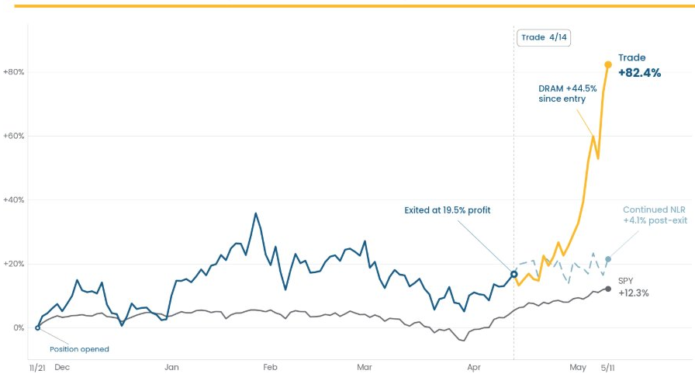
The AI Trade – Second Leg
Profit-taking and selective new exposure
REDUCED EXPOSURE
Symbol | Name | Action | Since
GOCT | FT Vest Buffer Oct. | Full exit -3% | +2.7%
NLR | Uranium & Nuclear | Full exit -4% | +4.1%
SCHD | Schwab Dividend | Trim -1% | +3.1%
INCREASED EXPOSURE
Symbol | Name | Action | Since
DRAM | Roundhill Memory | New +4% | +44.5%
MSFT | Microsoft | New +4% | +4.1%
Bouchey Financial Group | For Discussion Purposes Only | May 2026
Notes:
NLR Trade Exit
The dark blue line represents NLR, which we bought in November 2025 as the first leg of our AI-themed trade. We exited last month for a gain of +16.9%, while the S&P 500 which is represented by the grey line at the bottom was up just 5.9% over that same period. The dashed line shows where NLR sits today, had we held it. The grey line at the bottom is the S&P 500 comparison.
Rotating into DRAM
We rotated those gains directly into a new ETF called DRAM, up 44.5% since we entered last month. Our conviction in nuclear energy as a long-term power source for AI hasn't changed. As a committee, though, we saw a stronger near-term opportunity in hardware and memory. DRAM is represented on the chart in front of you by the yellow line which is up 44.5% since we bought into it last month. For comparison the S&P500 during this same time frame is up only 7%.
I'll walk through DRAM in more detail in a couple of slides.
Adding Microsoft
The second leg of this AI trade we added MSFT to the portfolio. When we bought it last month, MSFT had a very compelling valuation entry point, and I'll cover the details on the next slide.
Funding the Trade
To fund Microsoft, we fully exited GOCT, our buffered ETF that had a solid two-year run in the portfolio. We also trimmed SCHD by 1%. At the time, SCHD was up nearly 13% year-to-date, holding up well as a defensive position. We captured those gains and redeployed into a higher-conviction area of the market.

Slide 15
MSFT · Microsoft
Added April 14, 2026
PRICE PERFORMANCE · % OFF ALL-TIME HIGH
RETURN SINCE ACQUISITION
Entry 4/14
+4.1%
vs. SPY +5.6% over the same period
THE SETUP
Hardware/chip rally pulled capital out of software through Q1 2026
MSFT down 18.5% YTD and 29.5% from ATH at our entry
WHY WE BOUGHT
Added 4/14 at $391.72, funded by GOCT exit and SCHD trim
Q1 revenue +18% revenue YoY; cloud +40%; 36% net margin
CURRENT STANCE
Holding full weight
Sold off on CapEx narrative, not business deterioration
Bouchey Financial Group | For Discussion Purposes Only | May 2026
Notes:
Why We Bought Microsoft
At our entry point, MSFT was down 18.5% year-to-date and nearly 30% off its all-time highs. We view that selloff as a rotation story, not a fundamental one. The market has been moving out of software and into hardware, and the returns in SMH and our DRAM holdings support that thesis directly.
The CapEx Debate
One concern circulating among some investors is Microsoft's capital spending. They've committed roughly $100 billion in 2026 toward AI infrastructure buildout. We see that as a feature, not a flaw. AI isn't going anywhere, and companies that aren't deploying capital to build, integrate, or leverage it today will fall behind. Microsoft is making the right bet at the right scale.
The Fundamentals Back It Up
The earnings picture reinforces our conviction. In Q1 2026, MSFT reported 18% year-over-year revenue growth, 40% growth on the cloud side of the business, and net margins of 36%. These aren't the numbers of a company in trouble. They're the numbers of a company that was simply on sale.
Why Microsoft, and Why Now
I want to take a moment to explain how we think about an opportunity like Microsoft, because on the surface it doesn't fit our hardware theme. The best way I can do that is with an analogy most of us can relate to.
The Amazon Prime Shopper
Those of you who use Amzon Prime may now about this feature. Imagine you are in the market for a new Air Fryer, your old one is outdated and you need a new one. So, you do you research and fine the perfect airfryer on Amazon. It’s a Top-rated brand, stellar reviews, right size, right color. The only thing you don't love is the price. It's $100, no not discounted and at all-time highs. So you do what any disciplined shopper does. You save it for later.
Amazon Prime has a cool feature called a price tracker that gives you full transparency on the price of any product over the past year. Back in January, you see it was 10% off. In March it dipped to 20% off. But today it's back to $100.
A couple months go by. You're in your kitchen one morning making coffee, you glance over at that spot on the counter and think about how great that air fryer would look there. So you decide ro pull up Amazon and today is your lucky day. It's 30% off.
But you're a disciplined shopper. Before you click purchase, you check under the hood one more time. The reviews are still stellar, nothing negative has come out about the top company, and they still have your size and color in stock. Everything checks out. So, you buy it.
And I'll tell you this: that air fryer will see $100 again. Eventually it will hit a new all-time high of $110, $115, because over time everything gets more expensive.
That's Exactly What We Did with Microsoft
We added MSFT to our watchlist at 15% off its all-time highs. We watched it move to 20% off, then 30% off. As disciplined investors, we went back under the hood one more time. The fundamentals still checked out completely. The selloff had nothing to do with the business, and we saw it for what it was: an opportunity.
We bought it at nearly 30% off its all-time highs with the same confidence you had buying that air fryer. It is only a matter of time before Microsoft reaches those all time highs again, and when it does, that will be a beautiful thing for the portfolio

Slide 16
DRAM · Roundhill Memory ETF
Added April 14, 2026
PRICE PERFORMANCE · INDEXED FROM ACQUISITION
RETURN SINCE ACQUISITION
+44.5%
vs. SPY +5.6% over the same period
THE VEHICLE
Roundhill ETF with SK Hynix and Samsung as top holdings
Both names absent from SMH and other hardware ETFs
WHY WE BOUGHT
SK Hynix +198% YoY, Samsung +69% YoY with strong guidance
Direct memory exposure not available elsewhere in sleeve
CURRENT STANCE
Holding full weight as core AI infrastructure play
Supply-demand favorable; Q1 earnings reinforce setup
Bouchey Financial Group | For Discussion Purposes Only | May 2026
Notes:
Why DRAM
Our conviction in the hardware side of AI has been building for months. Two South Korean companies, SK Hynix and Samsung, had been on our watchlist for some time. The challenge was finding the right vehicle. No hardware-themed ETF held either name, until DRAM.
How We Got In
While researching those two companies, we came across a new ETF preparing to launch called DRAM, managed by Roundhill Investments. Once it went live on April 2nd, we called Roundhill's portfolio management team directly to walk through their outlook and better understand how the fund is managed. After that call, the committee was aligned. We moved with conviction.
We were among the first RIA firms to invest in DRAM when the fund's AUM was just $400 million on April 14th. Today it sits at nearly $7 billion, making it one of the fastest-growing ETFs on record.
The Earnings Back It Up
SK Hynix and Samsung both reported Q1 2026 earnings a few weeks ago. SK Hynix posted revenue growth of 198% year-over-year. Samsung was up 69% year-over-year. Both came with strong forward guidance and no signs of slowing.
Across the hardware sector broadly, demand continues to outpace inventory. That dynamic drives record growth and expanding margins going forward.
What You're Seeing on the Chart
The dark blue line is DRAM, up 44.5% over the past month since we entered the position. The grey line is the S&P 500, up roughly 7% over that same period.

Slide 17
Summary
Where the portfolio stands today
OUTPERFORMANCE
ACTIVE MANAGEMENT
POSITIONING
+6.4%
Two trades &
5 New Positions
Theme-led
BFG Equity Sleeve outperformance over the S&P 500 year to date, driven primarily by the November rebalance into semiconductors and nuclear.
The November rebalance and the April rotation each shaped current returns. Profit discipline was applied where original theses had played out.
Memory, semiconductors, nuclear, and large-cap software remain the working themes. Position sizes reflect both conviction and contribution to sleeve risk.
As always, reach out with any questions on positioning, trades, or how this fits your broader plan.

Slide 18
Disclosures
Please remember that past performance may not be indicative of future results. Different types of investments involve varying degrees of risk, and there can be no assurance that the future performance of any specific investment, investment strategy, or product (including the investments and/or investment strategies recommended or undertaken by Bouchey Financial Group, Ltd.), or any non-investment related content, made reference to directly or indirectly in this newsletter will be profitable, equal any corresponding indicated historical performance level(s), be suitable for your portfolio or individual situation, or prove successful. Due to various factors, including changing market conditions and/or applicable laws, the content may no longer be reflective of current opinions or positions. Moreover, you should not assume that any discussion or information contained in this newsletter serves as the receipt of, or as a substitute for, personalized investment advice from Bouchey Financial Group, Ltd.. Please remember to contact Bouchey Financial Group, Ltd., in writing, if there are any changes in your personal/financial situation or investment objectives for the purpose of reviewing/evaluating/revising our previous recommendations and/or services. Bouchey Financial Group, Ltd. is neither a law firm nor a certified public accounting firm and no portion of the newsletter content should be construed as legal or accounting advice. A copy of the Bouchey Financial Group, Ltd.’s current written disclosure statement discussing our advisory services and fees is available for review upon request.
+44.5%
Bouchey Financial Group | For Discussion Purposes Only | May 2026

