Slide 1
Q3 2025 Market &
Economic Update
October 15th, 2025

Slide 2


Presenters
Ryan Bouchey, CFP®, CPA
Chief Investment Officer
Paolo LaPietra, CFP®
Wealth Advisor & Portfolio Strategist

Slide 3
Government Shutdowns & All-time Highs
Today we will discuss:
  Economic Outlook
  AI Buildout & its impact
  What it means for the markets

Slide 4
Economic Overview

Slide 5
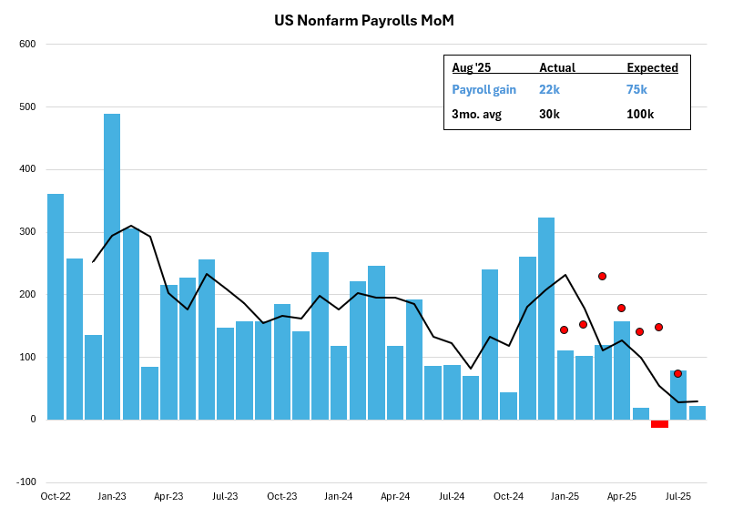
US Labor Market

Slide 6
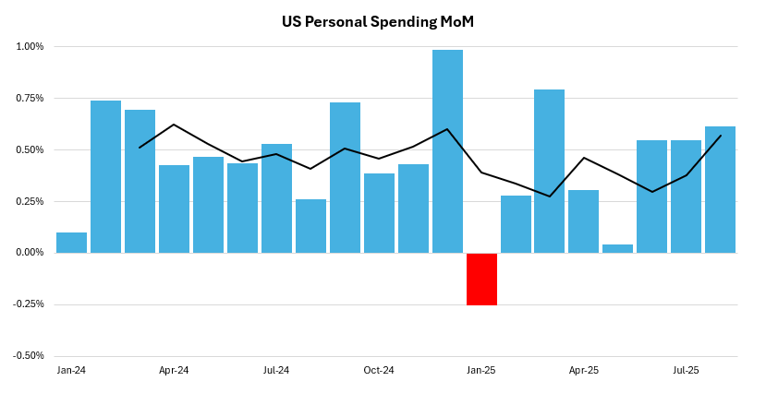
Consumer Spending

Slide 7
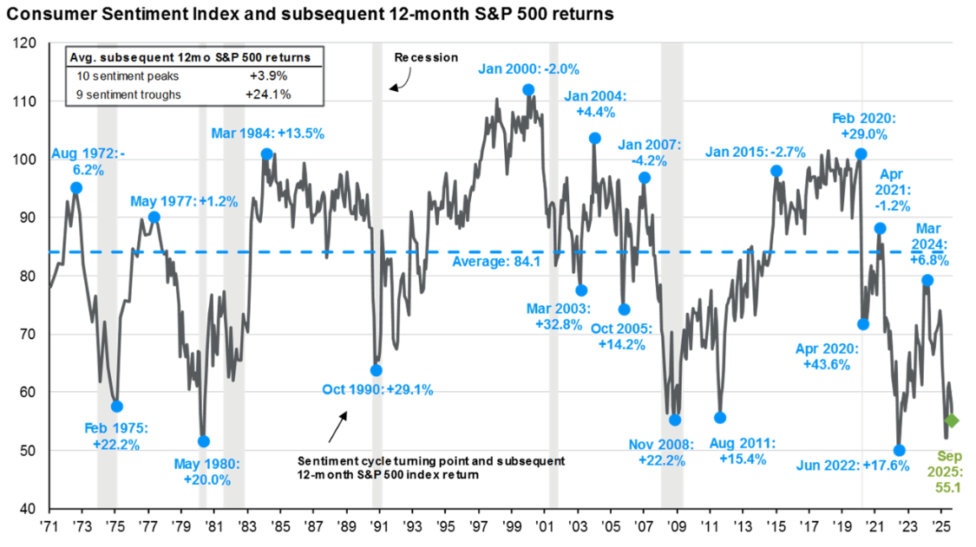
Consumer Confidence

Slide 8
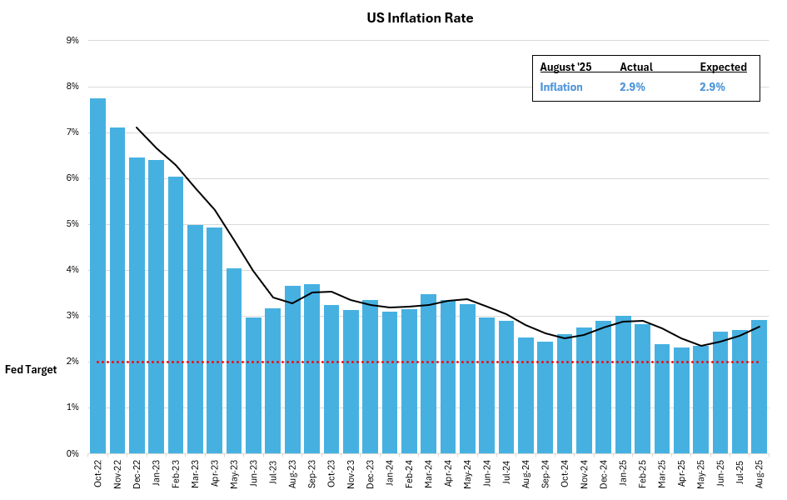
Inflation

Slide 9
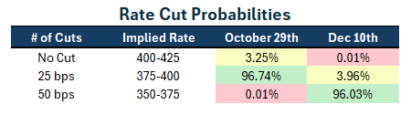
Interest Rate Outlook

Slide 10
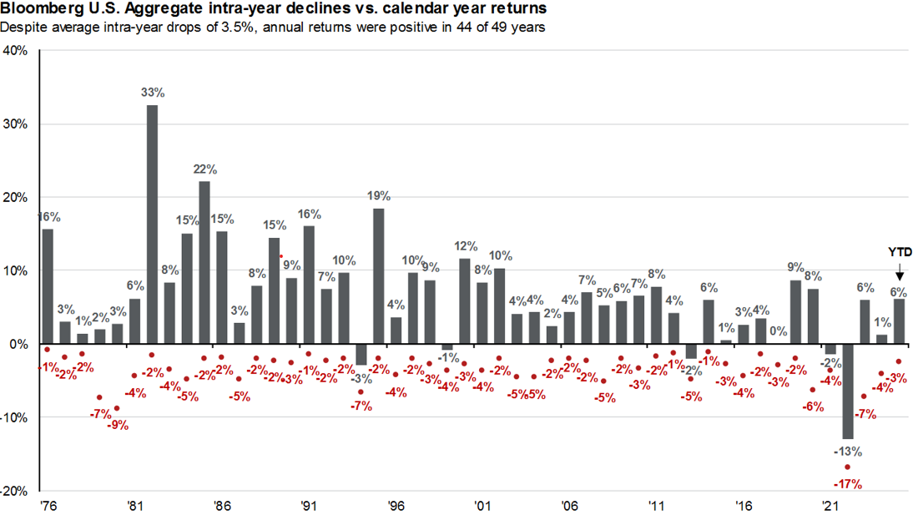
Positive Outlook for Bonds

Slide 11
Shutdowns, All-Time Highs to What’s Next

Slide 12
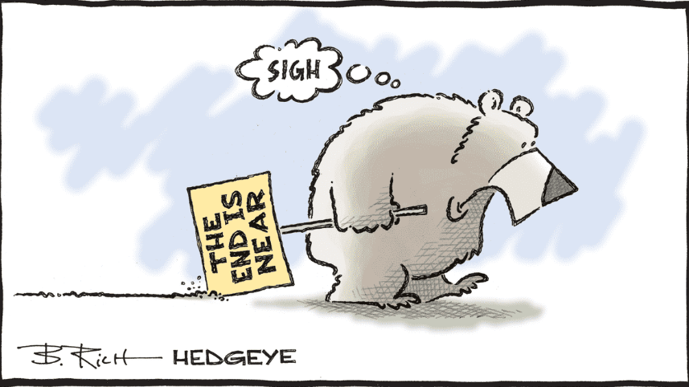
If You Focus on the Headlines...

Slide 13
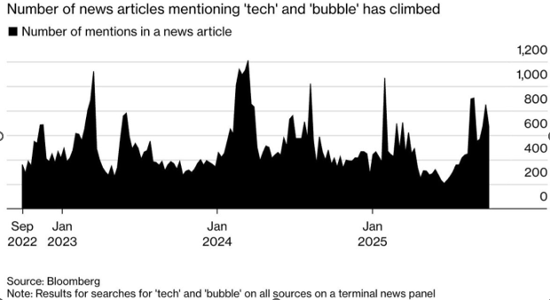
Bubble Fears on the Rise

Slide 14
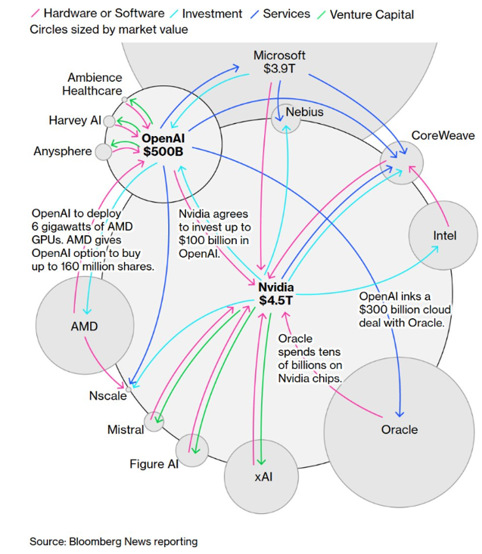
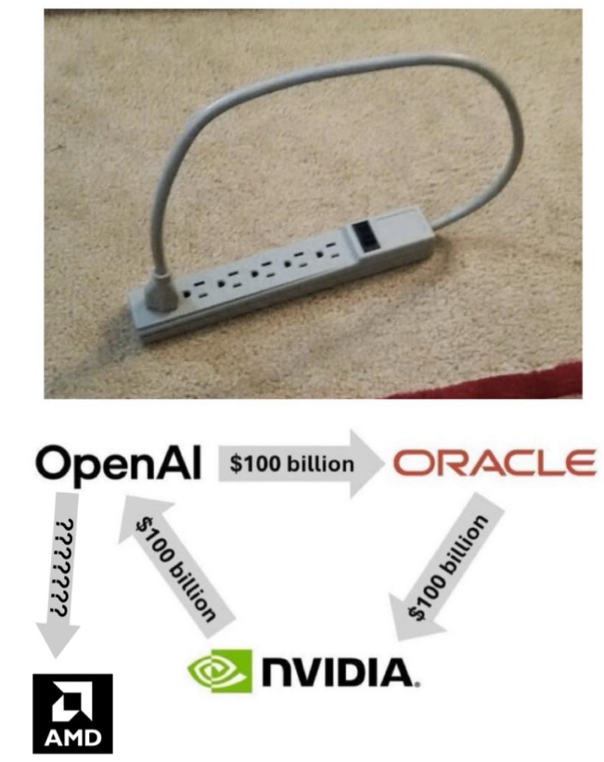
The Main Driver of this Fear
*Trung Phan – x.com

Slide 15
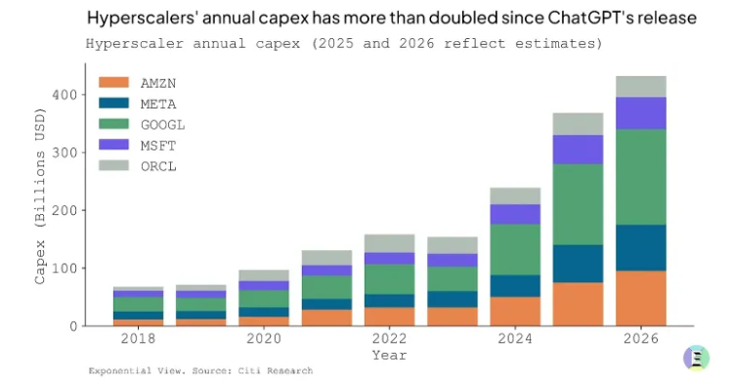
Capex Spending Growth

Slide 16
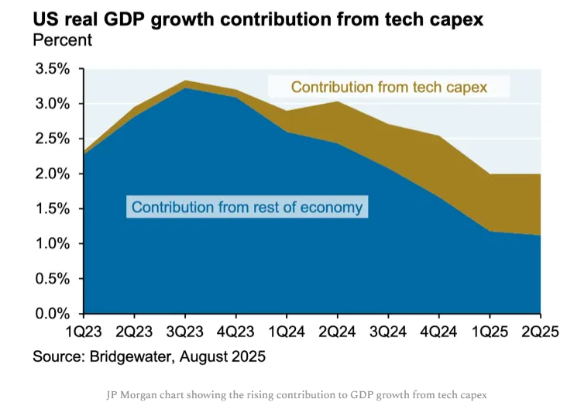
Impact on GDP

Slide 17
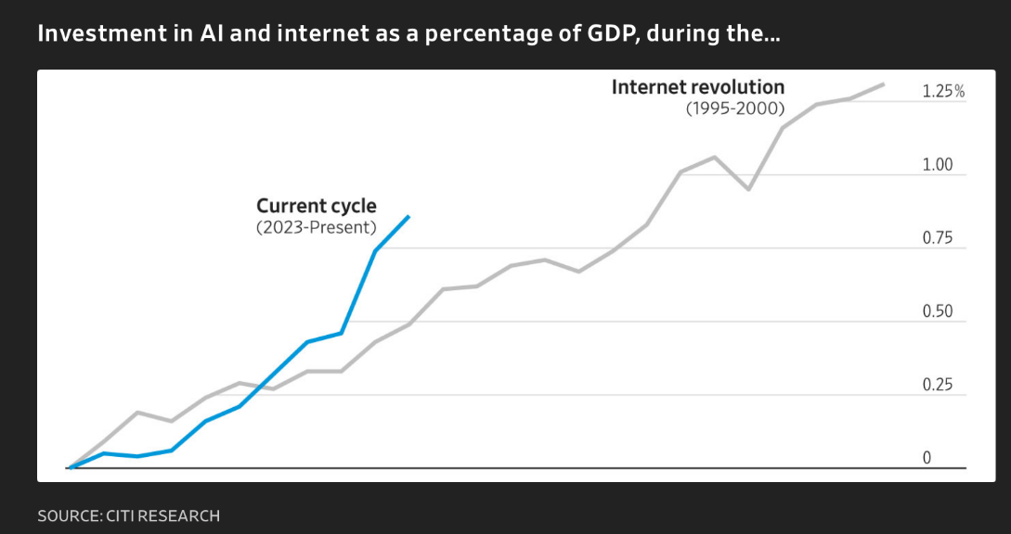
Surpassing 90’s Internet Spend

Slide 18
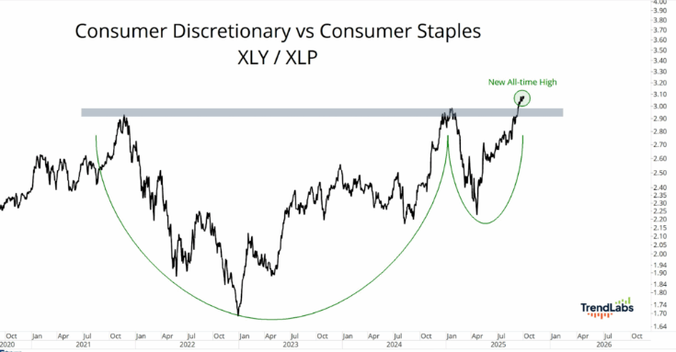
Consumer Strength

Slide 19
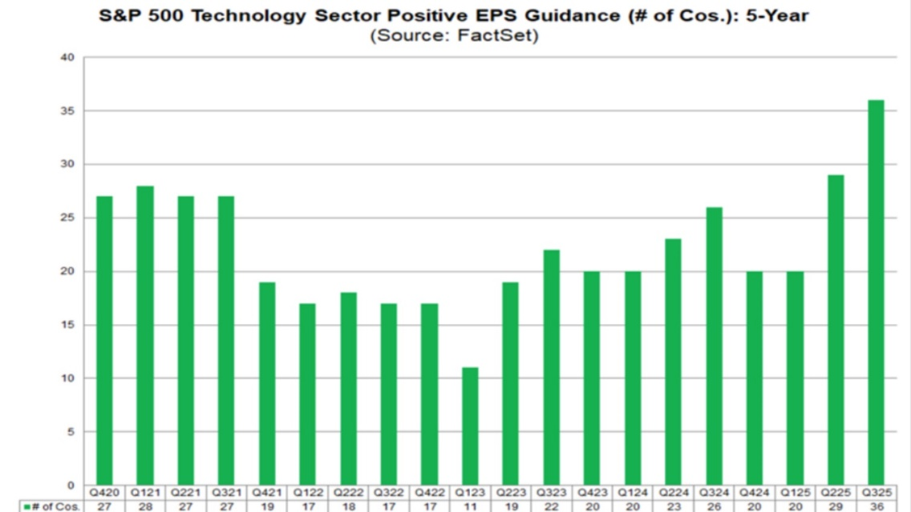
Earnings Strength

Slide 20
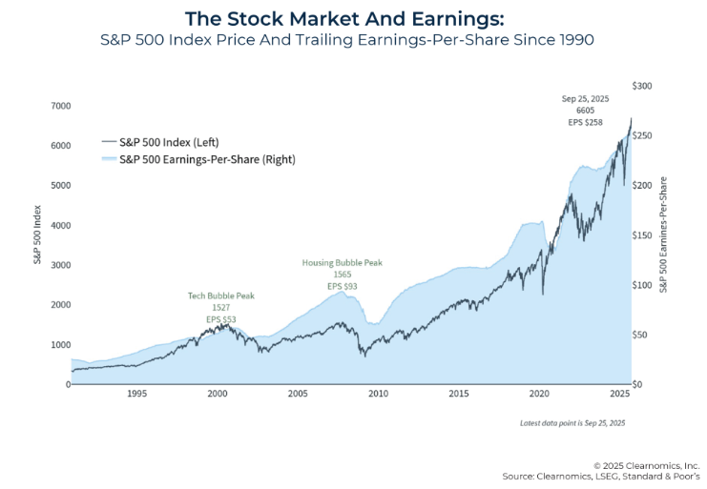
Markets Reflect Earnings

Slide 21
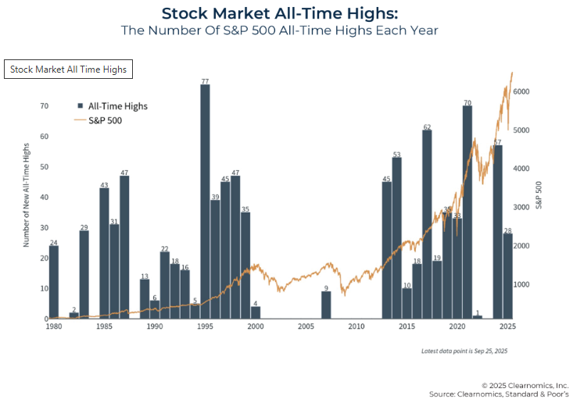
All-Time Highs Are OK

Slide 22
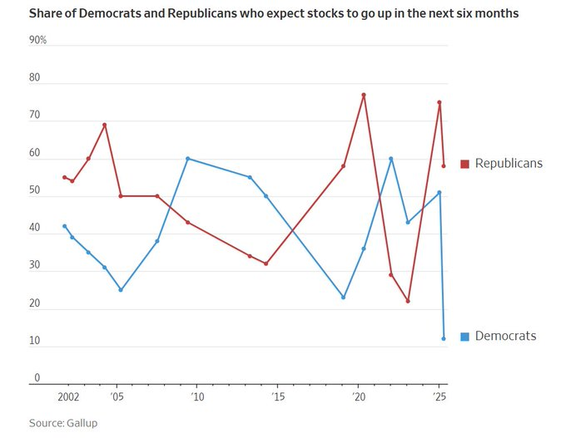
Gov’t Shutdown –
Human Behavior & Biases

Slide 23
Recap
We view the markets w/ 3 lenses
  1) Fundamentals – historically high
  2) Technicals – showing some signs of short-term volatility
  3) Human Behavior – nearly impossible to judge
The AI Revolution continues to propel markets
  This will create opportunities & risks
  Helping drive economic growth
Earnings are justifying market prices
  Tech weighting will naturally drive valuations higher
  As long as earnings keep pace

Slide 24
Thank you for joining us!

Slide 25
Disclosure
Please remember that past performance may not be indicative of future results. Different types of investments involve varying degrees of risk, and there can be no assurance that the future performance of any specific investment, investment strategy, or product (including the investments and/or investment strategies recommended or undertaken by Bouchey Financial Group, Ltd.), or any non-investment related content, made reference to directly or indirectly in this newsletter will be profitable, equal any corresponding indicated historical performance level(s), be suitable for your portfolio or individual situation, or prove successful. Due to various factors, including changing market conditions and/or applicable laws, the content may no longer be reflective of current opinions or positions. Moreover, you should not assume that any discussion or information contained in this newsletter serves as the receipt of, or as a substitute for, personalized investment advice from Bouchey Financial Group, Ltd.. Please remember to contact Bouchey Financial Group, Ltd., in writing, if there are any changes in your personal/financial situation or investment objectives for the purpose of reviewing/evaluating/revising our previous recommendations and/or services. Bouchey Financial Group, Ltd. is neither a law firm nor a certified public accounting firm and no portion of the newsletter content should be construed as legal or accounting advice. A copy of the Bouchey Financial Group, Ltd.’s current written disclosure statement discussing our advisory services and fees is available for review upon request.

